Slide 1
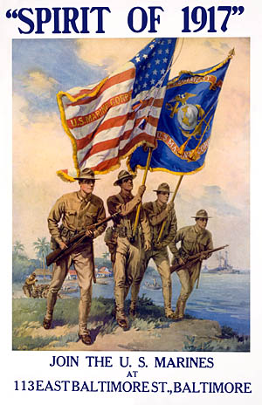
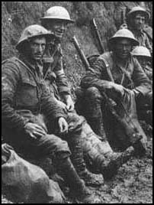
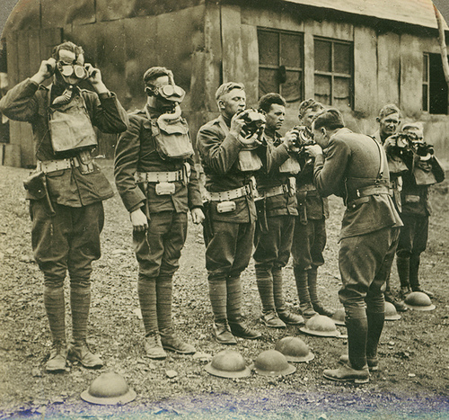
World War I
The Home Front

Slide 2
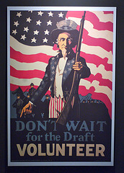
Selective Service Act
Prior to American entry into the war, the U.S. had a volunteer army of about 200,000 soldiers.
In May 1917, Congress passed the Selective Service Act, which created a national draft.
This is the 1st time the
U.S. government had established a draft before entering a war.
/

Slide 3
Originally ages 21-30
Expanded to 18-45
24 million registered and over 4.8 million men served during the course of the war

Slide 4
About 2 million American Men on the Western Front
Over 300,000 men evaded the draft by failing to show
4,000 classified as Conscientious Objectors

Slide 5
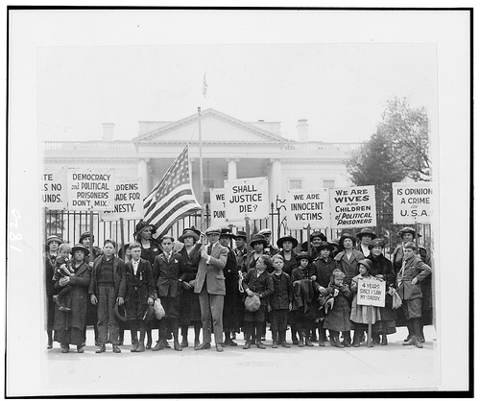
Opposition to the War
When President Wilson called the nation to war, he knew that not all Americans would respond with enthusiasm.
For religious or political reasons, some Americans opposed the war.
/

Slide 6
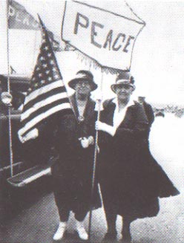
Jane Addams
In January 1915, a group of women led by Jane Addams (Hull House) held a peace conference in Washington, D.C.
They called for limitation of arms and mediation of the European conflict rather than combat.
Conference leaders formed the Woman’s Peace Party.

Slide 7
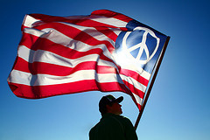
Pacifists are people who for political, moral, or religious reasons oppose all wars.
/

Slide 8
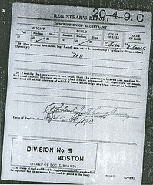
Conscientious Objectors
A conscientious objector is someone who opposes war for religious or moral reasons and therefore refuses to serve in the armed forces.
Those who refused to serve risked going to prison.
Draft Notice
/

Slide 9
(En)forcing “Patriotism”
George Creel (CPI)
Banned German language
Sauerkraut = Liberty cabbage
Frankfurters = hot dogs
Immigration restrictions against Germans
US War in Iraq
French Fries = Freedom Fries

Slide 10
As the nation geared up for war, industries began to shift from consumer goods to war production.
In July 1917, Woodrow Wilson created the War Industries Board (WIB) to direct industrial production.
The WIB coordinated the work of government agencies and industry groups to make sure supplies and equipment were produced and delivered to the military.

Slide 11
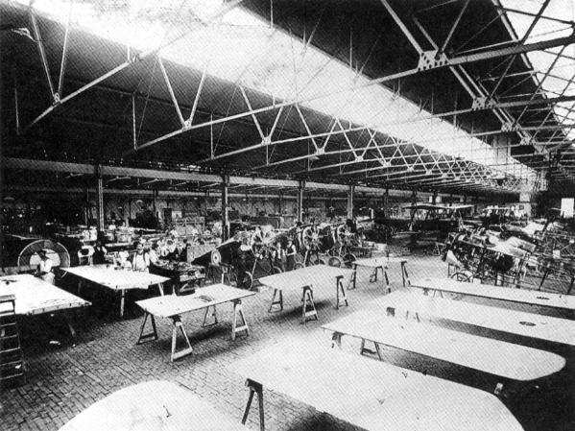
The National War Labor Board set standards for wages, hours, and working conditions in war industries.
As a result, labor unrest subsided for the duration of the war.

Slide 12
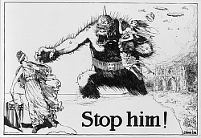
To help the government “sell” the war to the public, the president created a propaganda agency know as the Committee on Public Information.
The agency hired reporters, artists, movie directors, writers, and historians to create a massive propaganda campaign .
The agency put out press releases supporting the war effort.
http://www.futureofthebook.org/blog/archives/wwi-propaganda-kong-sm.jpg

Slide 13
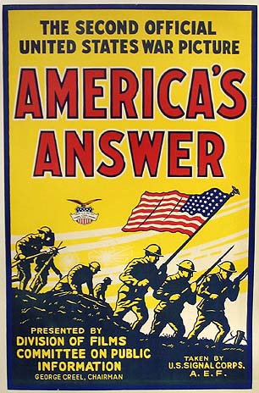
Propaganda Movies
The Committee on Public Information produced films such as The Kaiser, Beast of Berlin, and Claws of the Hun.
These movies showed the Germans as evil savages out to take over the world.
http://www.etymonline.com/columns/ww1-film.jpg

Slide 14
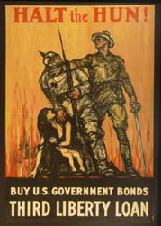
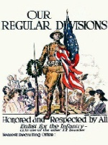
Posters urged Americans to join the army and buy bonds.

Slide 15
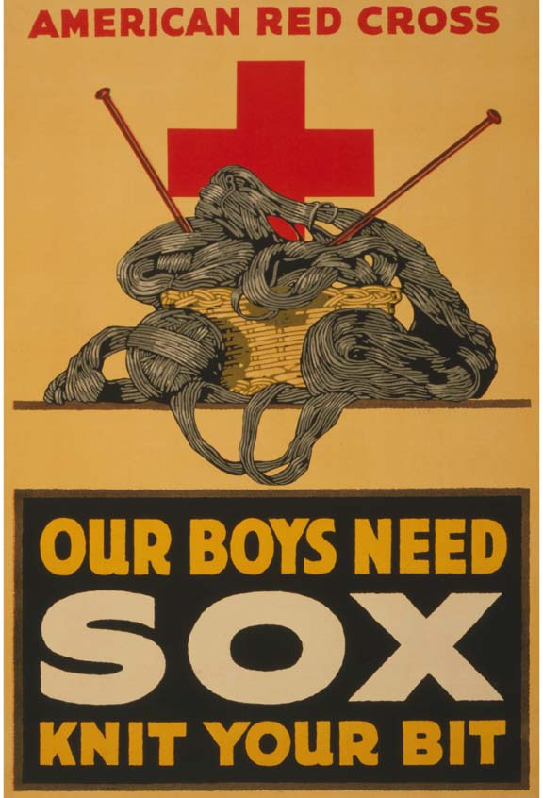
Supporting the Effort at Home
In schools, children saved tin cans, paper, and old toothpaste tubes for recycling into war materials.
Women met in homes or at churches to knit blankets and socks for soldiers.

Slide 16
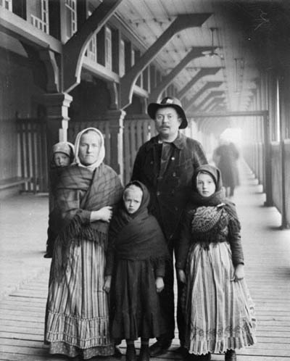
Anti-German Hysteria
Propaganda and patriotism sometimes had the unfortunate effect of stirring up anti-German feelings.
German American communities suffered the suspicions of others.
Employers in war industries fired German American workers,
fearing sabotage.
German Immigrants

Slide 17
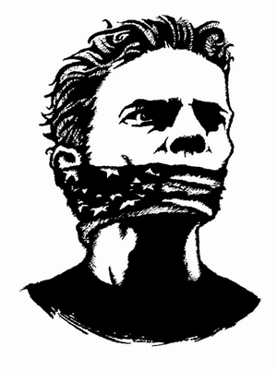
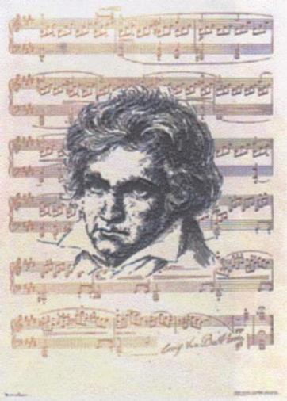
Censorship
For many Americans, all things German became associated with disloyalty.
Symphonies stopped playing music by German composers.
Libraries removed books by German authors.
Beethoven Banned

Slide 18
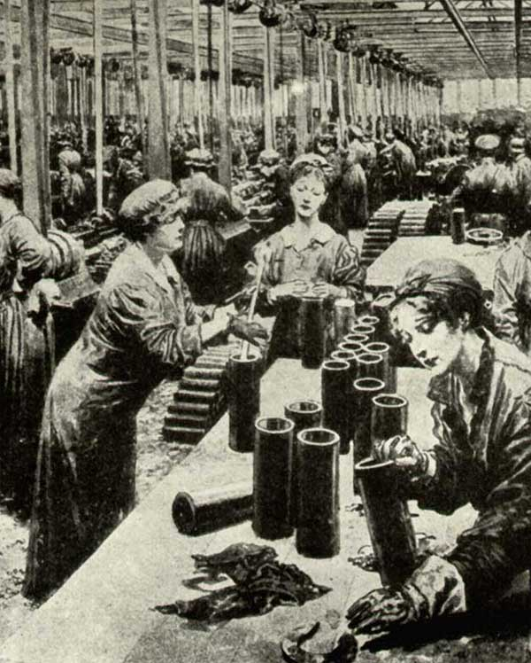
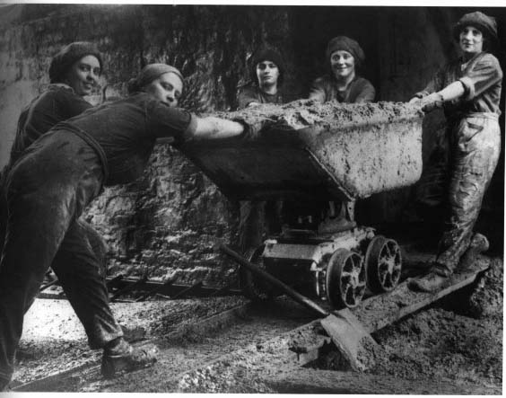
The Working Women
During the war, women took over many jobs traditionally done by men.
Examples: bank clerks, ticket seller, elevator operator, chauffer, street car conductor, factory worker, and farmer.

Slide 19
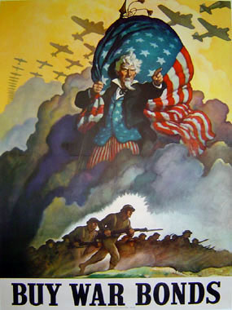
Paying for the War: Bonds
The government raised the rest of the money through the sale of war bonds.
A bond is a certificate issued by the government that promises to pay back the money borrowed at a fixed rate of interest.

Slide 20
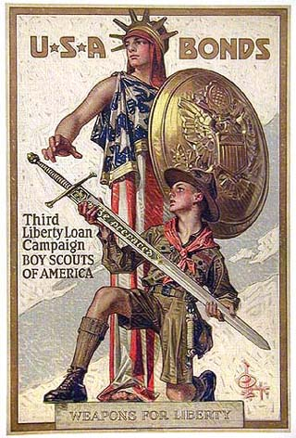
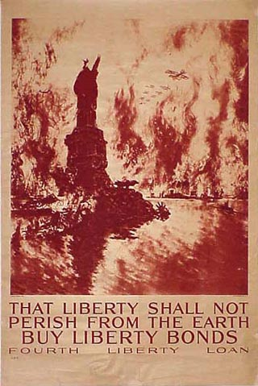
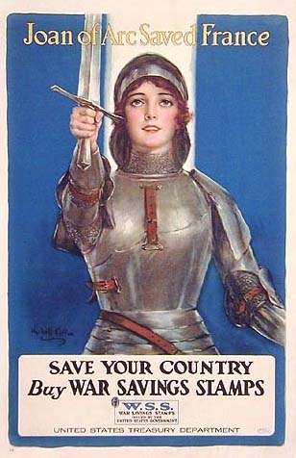
The purchase of Liberty Bonds by the American public provided needed funding for the war and gave Americans a way to participate in the war effort.
In big cities, movie stars and sports heroes urged people to buy bonds.

Slide 21
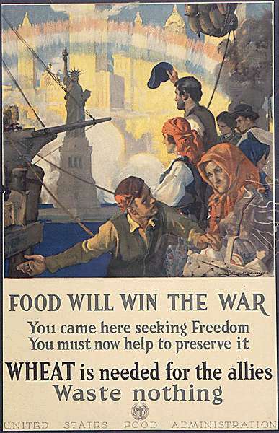
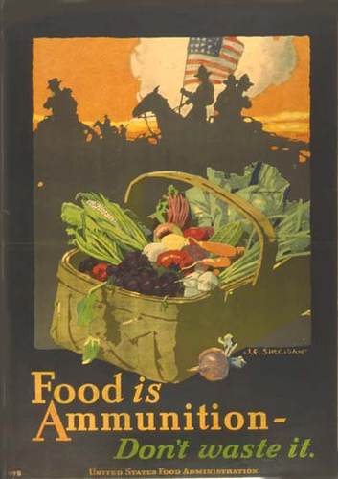
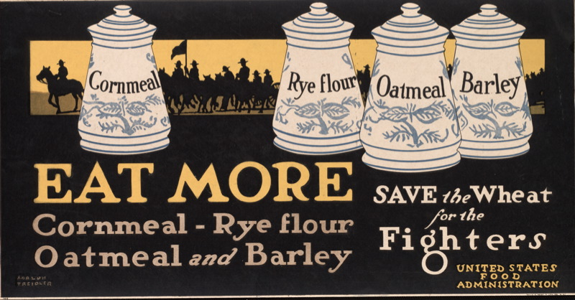
Food
The U.S. faced the huge responsibility of feeding the armed forces, as well as Allied troops and civilians.
To meet the challenge, Wilson set up the Food Administration to oversee production and distribution of food and fuel.

Slide 22
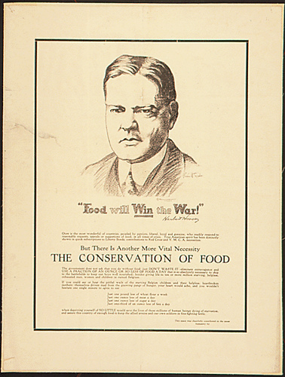
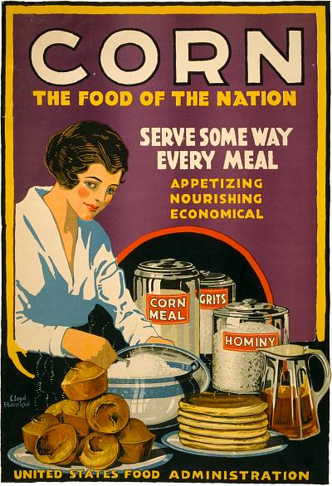
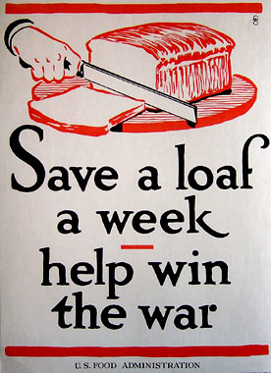
Wilson chose future president, Herbert Hoover to head the Food Administration.
Hoover raised crop prices to encourage farmers to produce more food and began a campaign that urged Americans to conserve food and reduce waste.

Slide 23
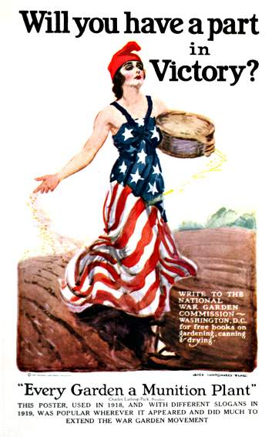
Conserving food was part of the war effort.

Slide 24
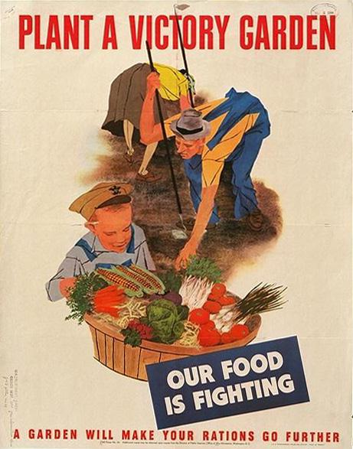
“Victory Gardens”
Using the slogan “Food will win the war,” he urged families to participate in Meatless Mondays and Wheatless Wednesdays.
Hoover called on Americans to increase the food supply by planting “victory gardens.”

Slide 25
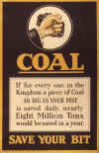
Fuel Conservation
The Fuel Administration met the nation’s energy needs through a combination of increased production and conservation.
To conserve energy, Americans turned down their heaters and wore sweaters on “heatless Mondays.” On “gasless Sundays,” they went for walks instead of driving their cars.

Slide 26
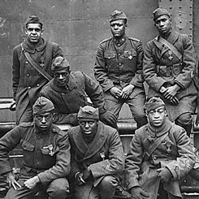
African Americans
President Wilson asked Americans to help make the world “safe for democracy,” but many African Americans wondered more about democracy at home.
With lynchings, Jim Crow laws, and segregated army units, some were not sure what they should be fighting for.

Slide 27
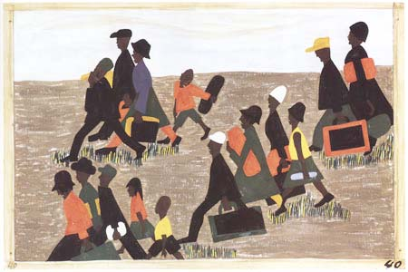
Great Migration
As production of war materials rose, thousand of new jobs opened up in the North at the nation’s steel and auto factories. The mining and meatpacking industries also needed more workers.
Black newspapers urged southern blacks to leave home and take advantages of these opportunities in the North (The Great Migration.)

Slide 28
Espionage and Sedition Acts
The Government cracks down on espionage or spying by passing the Espionage & Sedition Acts.
These laws made it a crime to try to interfere with the military draft.
These laws made it illegal to express opposition to the war.

Slide 29
Government Control during WWI
Espionage Act: Made it a crime to spy, sabotage, refuse military service if drafted, or obstruct military recruitment.(1917)
Sedition Act: Made it a crime punishable by imprisonment to say anything “disloyal, profane, or abusive about the government or armed forces.(1918)

